Slide 1
FAKE NEWS DETECTION - NLP

Slide 2
PROBLEM DEFENITION
Data cleaning and removal of unnecessary spaces and stop words
Developing a classification model to distinguish between fake news and authentic news.

Slide 3
DATA CLEANING AND PREPROCESSING
Features like id, and written by were removed
Headline and news were cleaned by removing spaces and punctuations
The two columns were merged into a single feature

Slide 4
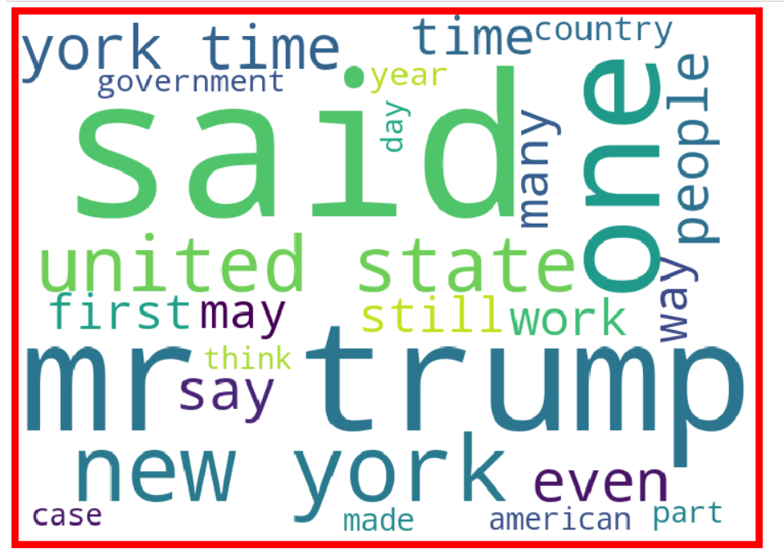
Visualizations
Word cloud was used to identify patterns in fake and authentic news.
No specific patterns were observed, there were a lot of fake news regarding USA and Donald Trump

Slide 5
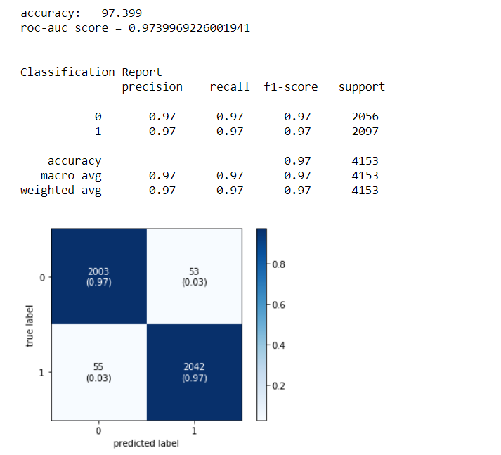
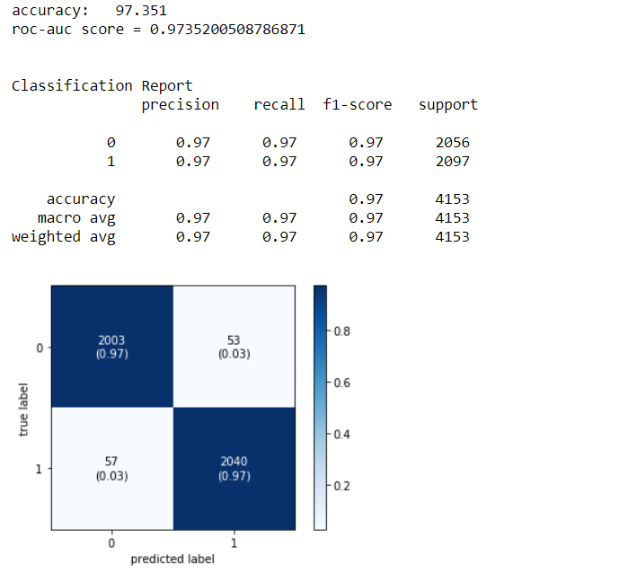
Modelling and Metrics
Linear SVC was found to be the best model with an accuracy score of 97.4%
Accuracy, confusion matrix, precision, recall and f1 score were chosen as the metric.

